Slide 1
Drone Detection Project
Denis Dagaev
Evgeniy Zaborschikov

Slide 2
Problem statement
We have a collection of 14 black-white videos with annotations of drones presented on them
Task: develop and train model to detect drones in real-time on the videos
Criteria: evaluate model performance on the given annotations and calculate metrics

Slide 3
Dataset exploration
Dataset contains 14 videos
Total 38948 frames
48.6% of images with no drones detection

Slide 4
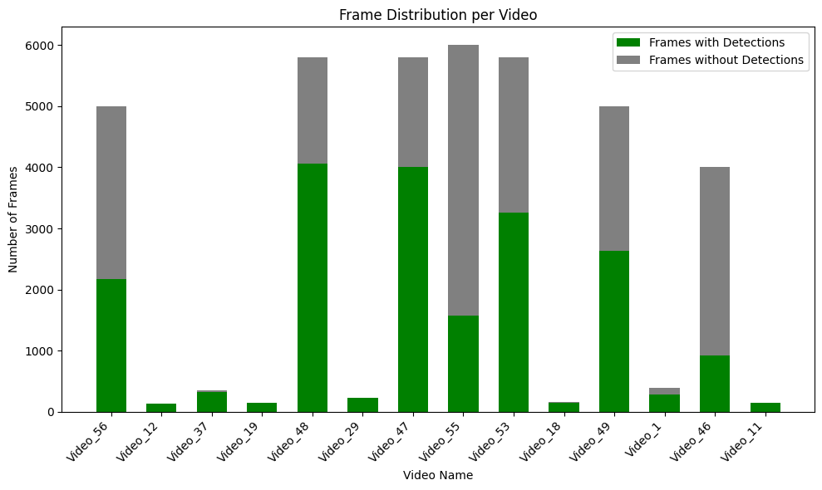
Data exploration

Slide 5
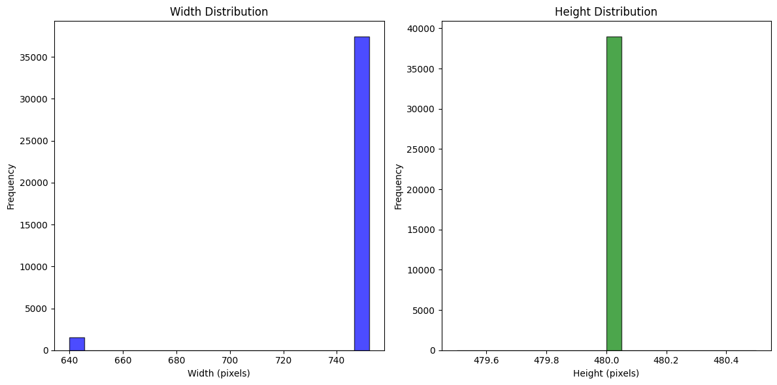
Images resolution

Slide 6
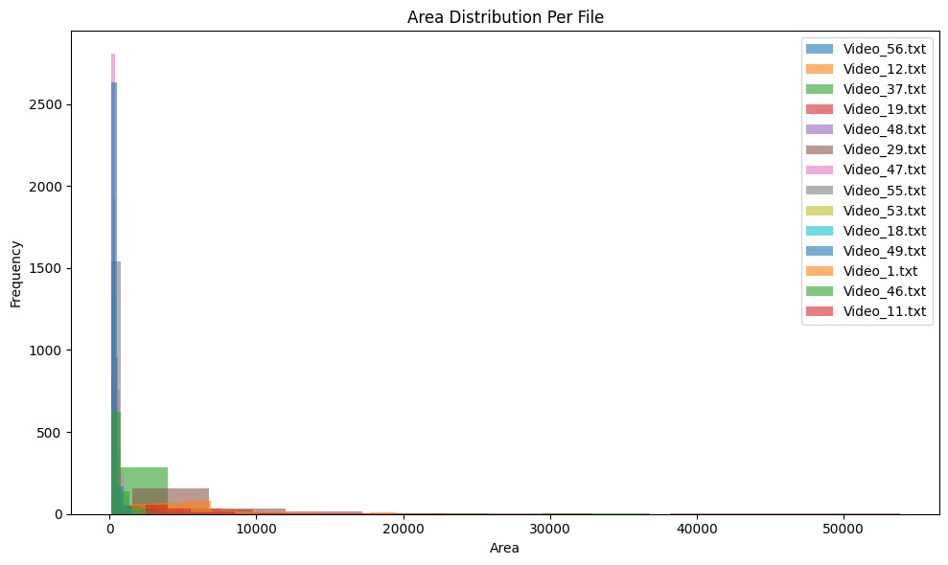
Drone’s area

Slide 7
Data preprocessing
Since all images has the same height and 2 different widths, 2 approaches have been proposed: letterboxing and cropping
Crop to 480x480 was chosen in order to save size of objects (most of them too small)

Slide 8

Architecture selection
YOLOv11m
RT-DETR

Slide 9
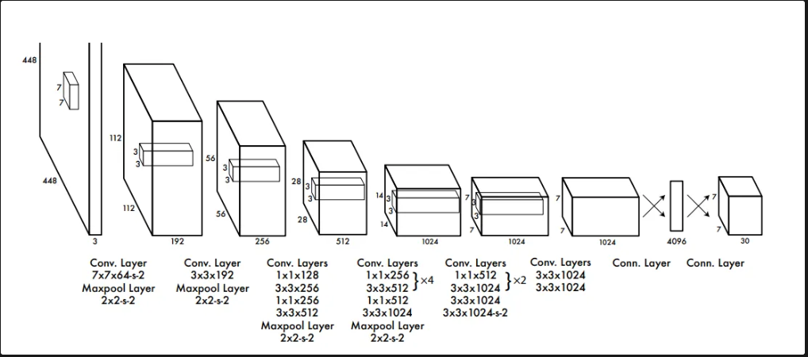
Yolo network architecture
The core of YOLO's architecture is a single convolutional neural network (CNN) that simultaneously predicts multiple bounding boxes and class probabilities for each bounding box. The key components of YOLO's architecture are:
Grid Division: The input image is divided into an S x S grid. Each grid cell is responsible for detecting objects whose center falls within it.
Bounding Box Prediction: Each grid cell predicts B bounding boxes, each with a confidence score. The confidence score reflects the probability that a bounding box contains an object and the accuracy of the bounding box.
Class Prediction: Each grid cell also predicts the class probabilities C for the object, given that an object exists in that grid cell.
Final Predictions: YOLO combines these predictions to generate the final detected objects, applying non-max suppression to eliminate redundant bounding boxes.

Slide 10
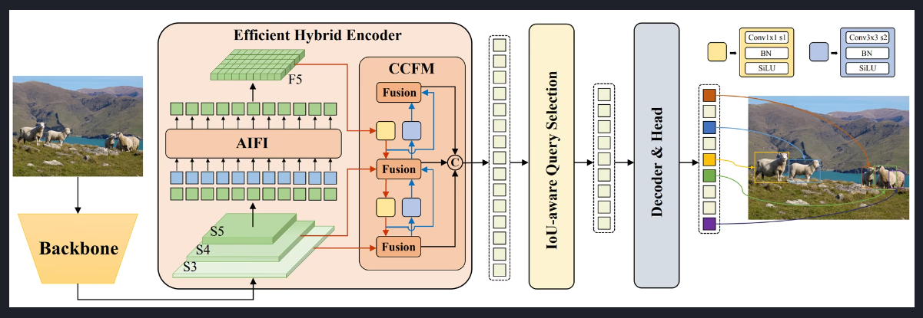
RT-DETR network architecture
The RT-DETR model architecture diagram shows the last three stages of the backbone {S3, S4, S5} as the input to the encoder. The efficient hybrid encoder transforms multiscale features into a sequence of image features through intrascale feature interaction (AIFI) and cross-scale feature-fusion module (CCFM). The IoU-aware query selection is employed to select a fixed number of image features to serve as initial object queries for the decoder. Finally, the decoder with auxiliary prediction heads iteratively optimizes object queries to generate boxes and confidence scores (source).
Key Features
Efficient Hybrid Encoder: Baidu's RT-DETR uses an efficient hybrid encoder that processes multiscale features by decoupling intra-scale interaction and cross-scale fusion. This unique Vision Transformers-based design reduces computational costs and allows for real-time object detection.
IoU-aware Query Selection: Baidu's RT-DETR improves object query initialization by utilizing IoU-aware query selection. This allows the model to focus on the most relevant objects in the scene, enhancing the detection accuracy.
Adaptable Inference Speed: Baidu's RT-DETR supports flexible adjustments of inference speed by using different decoder layers without the need for retraining. This adaptability facilitates practical application in various real-time object detection scenarios.

Slide 11
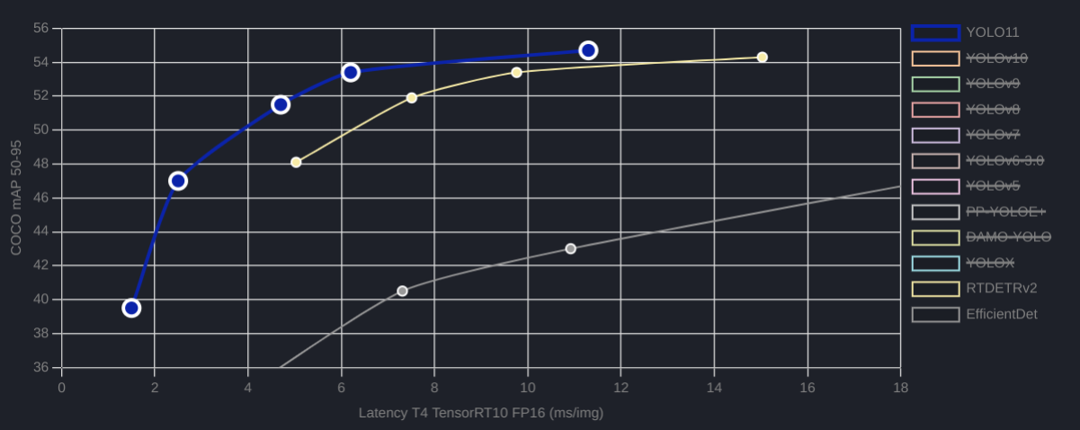
Performance Metrics

Slide 12
Data preparation
Conversion to YOLOv8 format with the following structure:
dataset
images
train
val
Test
labels
train
val
test
data.yaml

Slide 13
Data preparation
Converted origin annotations to YOLO format with convert_to_yolo(x1, y1, x2, y2, img_width, img_height) -> (center_x, center_y, width, height) in YOLO format.
Took all images with annotations and include 20% of no-detection images to make the dataset more diverse

Slide 14
Dataset prepared
Total number of images in dataset: 20364
Number of detections in dataset: 18704
Percentage of images with detection is 88.94%
Train/test/val splits with 70/15/15 ratio

Slide 15
Case 1: YOLOv11m
Ultralytics YOLOv11 M size model as SOTA object detection model
Train for 10 epochs on our dataset
Best result achieved at 8 epoch

Slide 16
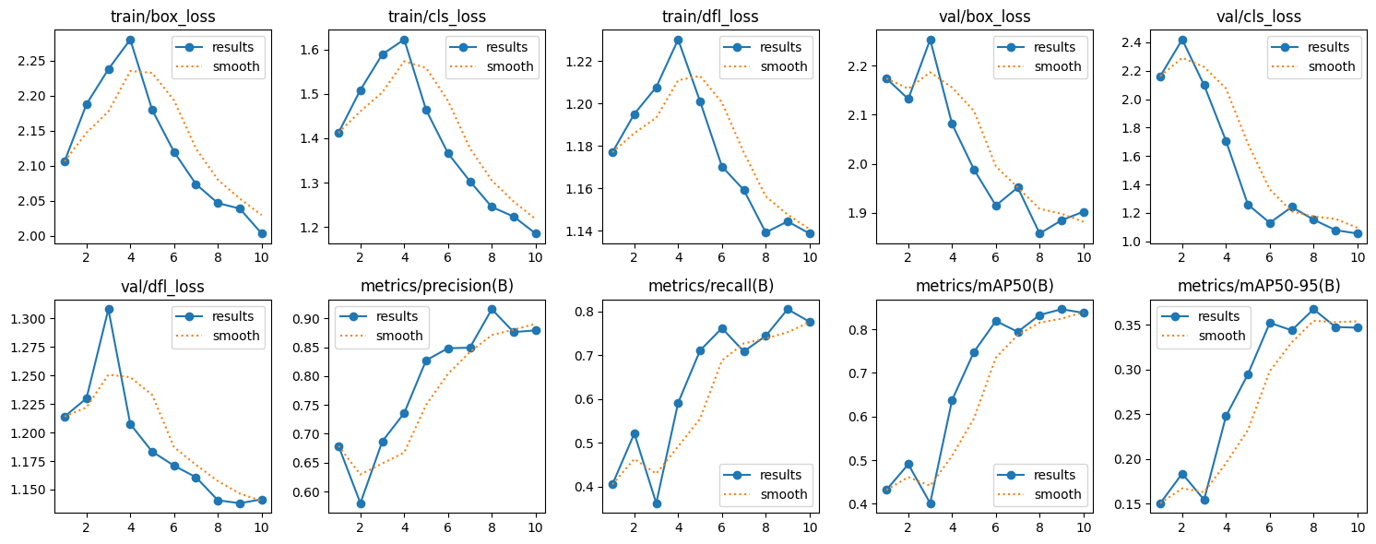
Case 1: YOLOv11m

Slide 17
Case 2: VisDrone pertained
Our dataset contains many small drone objects and also has a dynamically moving scene. This is very similar to drone-mounted footage. To improve the model's ability to distinguish small objects at fast speeds, it was decided to pre-train it on the VisDrone dataset.
VisDrone is composed of 288 video clips with 261,908 frames and 10,209 static images, captured by various drone-mounted cameras. The dataset covers a wide range of aspects, including location (14 different cities across China), environment (urban and rural), objects (pedestrians, vehicles, bicycles, etc.), and density (sparse and crowded scenes). The dataset was collected using various drone platforms under different scenarios and weather and lighting conditions.

Slide 18
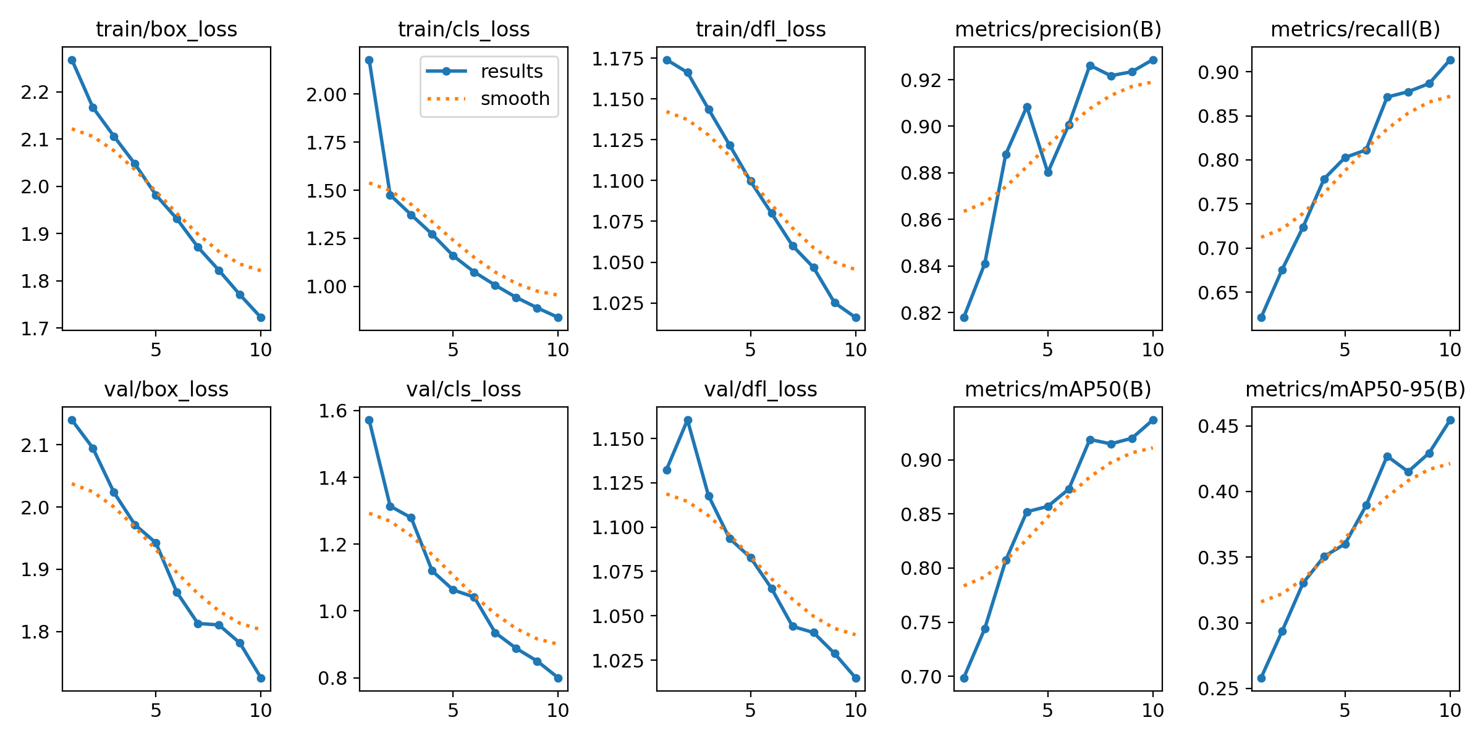
Case 2: VisDrone pertained

Slide 19
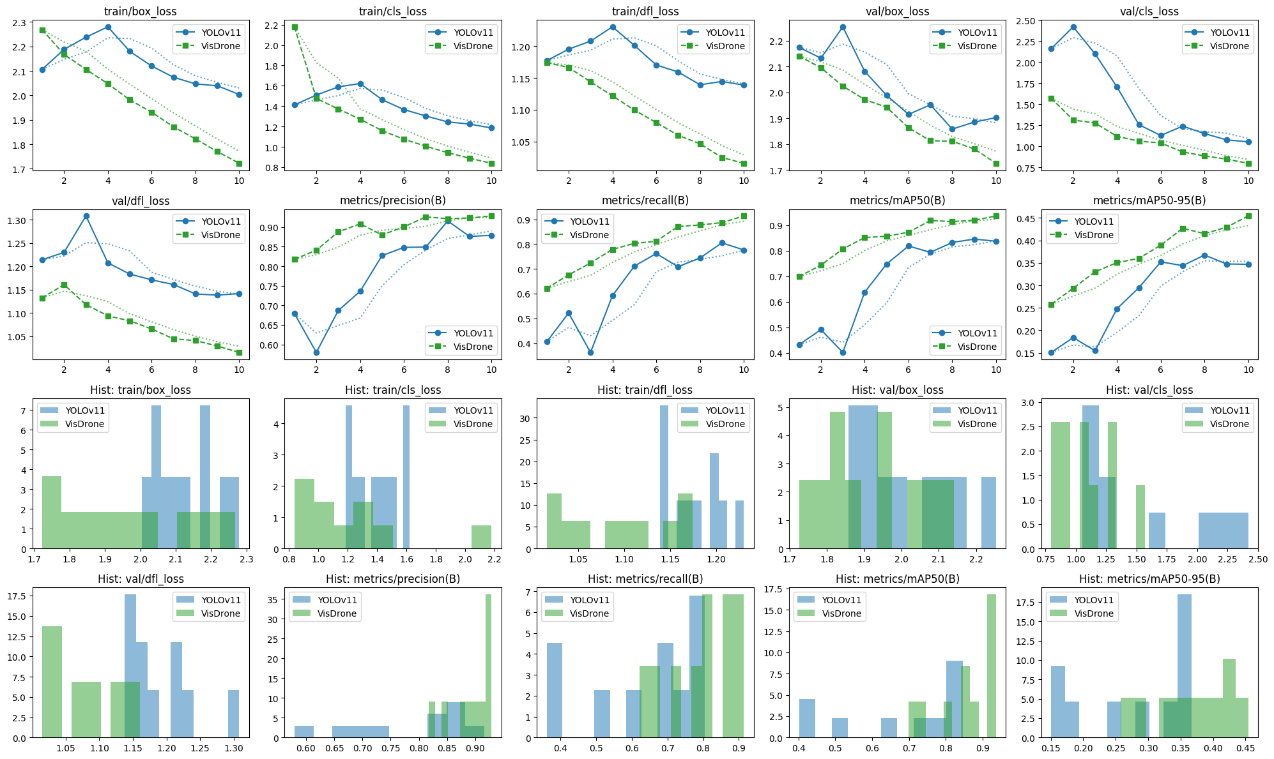
YOLOv11 vs YOLOv11 VisDrone pre-trained

Slide 20
YOLOv11 vs YOLOv11 VisDrone pre-trained
From the visualization, we can analyze the performance of the two models, YOLOv11 and VisDrone, based on their training and validation losses, as well as key metrics like precision, recall, and mAP.
Key Observations:
1. Loss Trends (Train & Validation)
• Both models show decreasing box_loss, cls_loss, and dfl_loss, which indicates that they are learning.
• VisDrone has consistently lower losses than YOLOv11, suggesting that it is optimizing better and learning representations more efficiently.
• YOLOv11’s train/dfl_loss increases initially before stabilizing, indicating possible training instability.
2. Precision & Recall
• VisDrone has higher precision(B) and recall(B) compared to YOLOv11 throughout training.
• This suggests that VisDrone is making fewer false positives and false negatives, meaning it is detecting objects more reliably.
3. mAP50 & mAP50-95 (Overall Detection Accuracy)
• VisDrone maintains a higher mAP50(B) and mAP50-95(B) than YOLOv11.
• This implies that VisDrone is achieving better localization and classification performance across various IoU thresholds.
4. Histograms (Metric Distributions)
• The histograms confirm that VisDrone’s losses are more concentrated in lower values, while YOLOv11 has a wider spread, indicating inconsistency.
• The distribution of precision, recall, and mAP for VisDrone shows more compact, higher values, further validating its superior performance.
Conclusion:
✅ VisDrone outperforms YOLOv11 in all key metrics (lower losses, higher precision, recall, and mAP).
❌ YOLOv11 has higher losses and fluctuating dfl_loss, indicating less stability during training.
🎯 VisDrone is the better choice for this task as it generalizes better and detects objects more accurately.

Slide 21
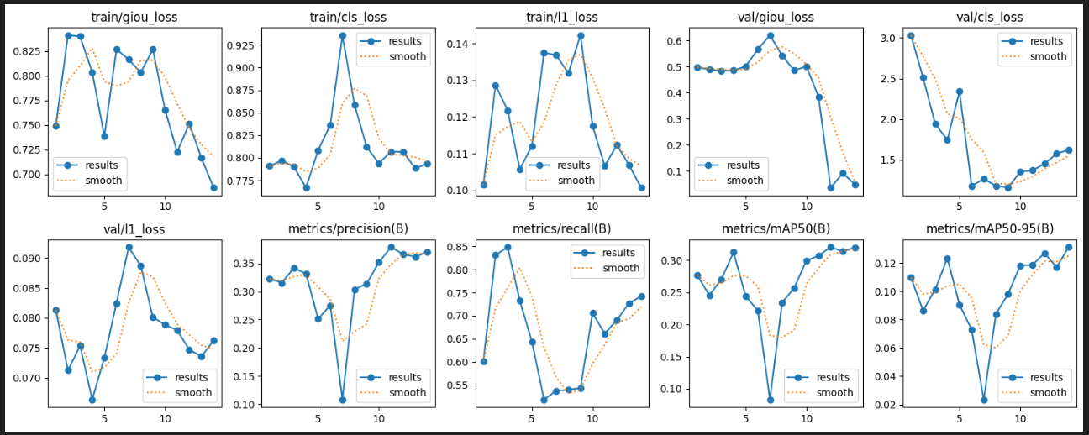
CASE 3: RT-Detr (‘rtdetr-l.pt’)
Ultralytics RT-DETR L size model
Train for 14 epochs on our dataset
Best result achieved at 14 epoch

Slide 22
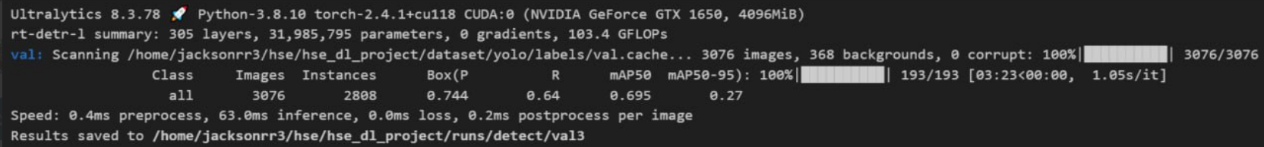
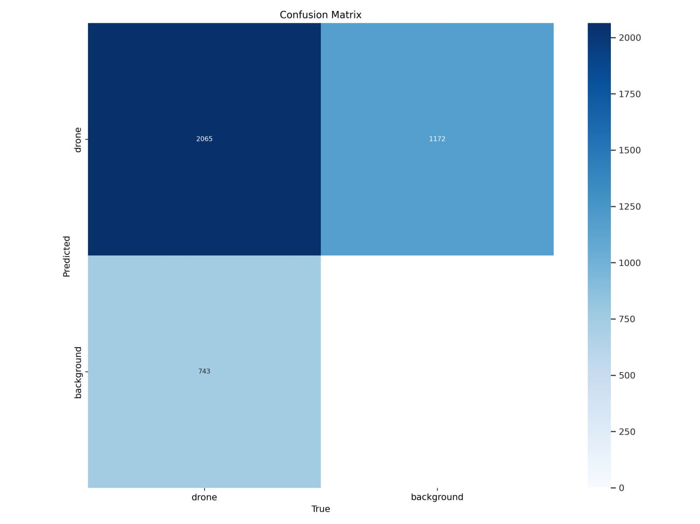
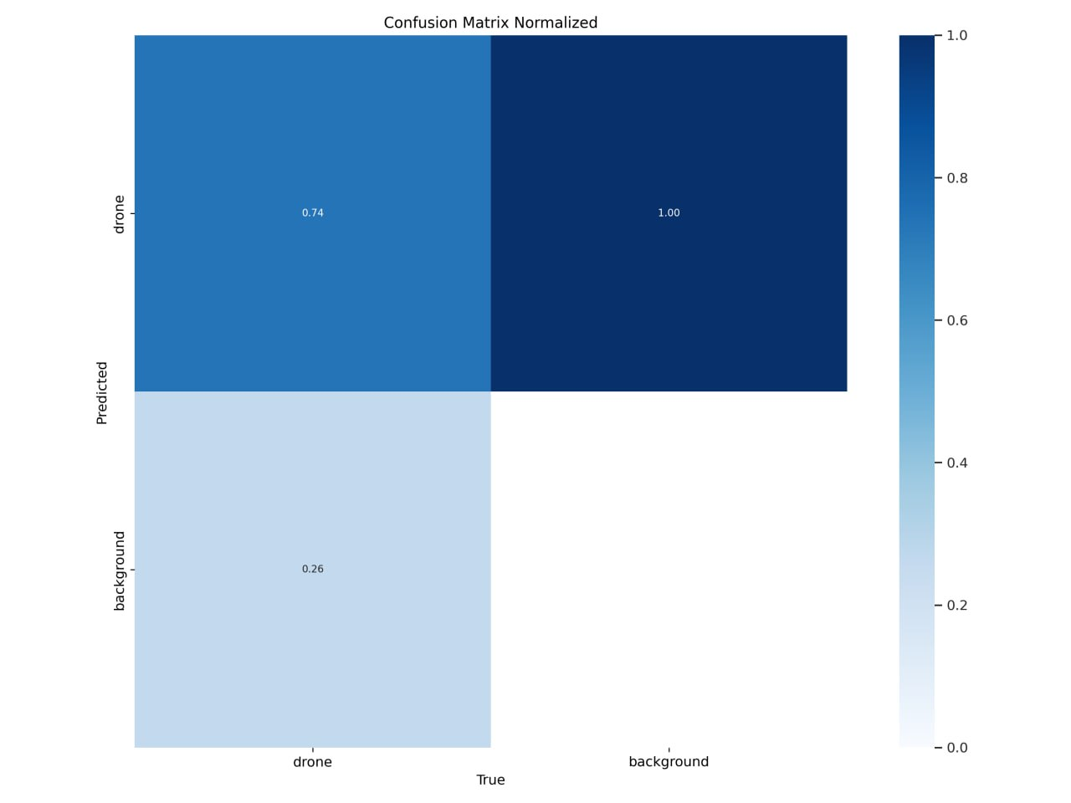
RT-DETR validation

Slide 23
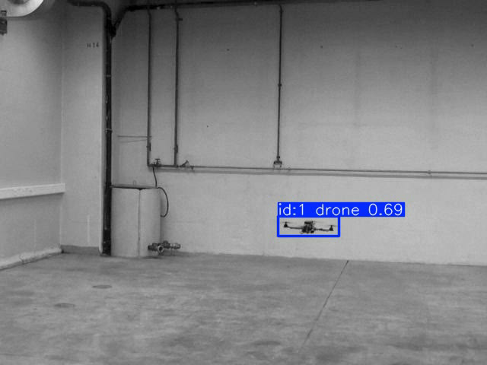
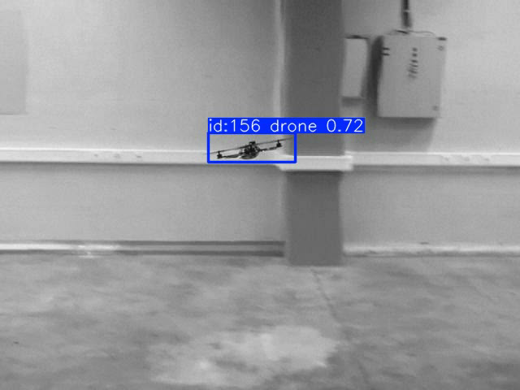
Video detections RT-Detr
Video_1
Video_12

Slide 24
